Slide 1

Software-Defined Factory Controller using Distributed RT Linux
RTOS Project Review-1
Wednesday, August 12th, 2026
 | Under the Guidance of Dr. Srikanth Cherukuvada Assistant Professor, Department of Computer Science and Engineering, KLH CSE Bowrampet Campus
Team Members P. Mahalakshmi-2420030313 S. Tejasree-2420030441 B. Sruthi-2420030578 K. Amulya-2420090132

Slide 2
Outline of Research Work
Focus
Introduction
Literature Survey
Challenges
Research Objectives
Conclusion & Future Work
References
Publications Details

Slide 3
Problem Statement
Centralized Control: Traditional factories depend on a single/main controller, creating a single point of failure.
Hardware Dependency: Conventional systems rely heavily on specialized hardware and PLCs, increasing cost and limiting flexibility.
Limited Scalability: Adding new machines or production units can require major hardware and configuration changes.
Lack of Flexibility: Changing control logic is often difficult because it is closely tied to the underlying hardware.
Real-Time Requirement: Factory operations require fast and predictable responses to sensor inputs and machine events.
Need for Better Architecture: A distributed, software-defined, real-time control system is needed to make factory automation more flexible, scalable, and modular.
Our Solution: We address this using multiple RT Linux-based controller nodes that independently control factory operations and communicate over a network.

Slide 4
Objectives
Develop a software-defined factory controller for an automated conveyor-based sorting process.
Implement distributed control by assigning conveyor, detection, and sorting tasks to separate RT Linux nodes.
Achieve real-time operation by processing sensor inputs and generating machine-control commands with predictable response.
Enable inter-node communication so different controllers can coordinate the complete sorting process.
Provide flexible control logic that can be modified or updated through software without major hardware changes.
Design a modular and scalable architecture that can be extended to additional machines, sensors, and factory processes.
Demonstrate reliable coordination between sensors, controllers, and actuators in an industrial-style environment.

Slide 5
Literature Survey
Authors | Title of the Paper | Methodology | Inferences | Limitation/Future work
Reghenzani et al. [1] | The Real-Time Linux Kernel: A Survey on PREEMPT_RT (2019) | •Surveys PREEMPT_RT architecture and real-time Linux approaches • Studies preemption, scheduling and real-time behaviour • Explores Linux on COTS hardware for real-time applications | • Shows that Linux can be adapted for real-time workloads • PREEMPT_RT provides improved timing predictability compared with general-purpose Linux • Establishes RT Linux as a suitable foundation for our controller | • Focuses mainly on the OS/kernel real-time aspects, not distributed factory-control orchestration • Does not address software-defined task redistribution across multiple RT Linux nodes
Kim et al. [2] | Software-defined Factory: Paradigm Shift in Manufacturing Towards Industry 5.0 (2025) | • Proposes a Software-Defined Factory architecture • Decouples product, process and factory functions from conventional hardware • Discusses digital twins, robotics, AI, wireless networks and cloud technologies | • Establishes Software-defined factory as a way to make manufacturing more flexible and reconfigurable • Supports the idea of separating factory functionality from fixed hardware | • Provides a high-level SDF architecture, but does not specifically investigate distributed RT Linux task execution and end-to-end real-time scheduling
Mohamed Khalgui [3] | A Deployment Methodology of Real-Time Industrial Control Applications in Distributed Controllers, Computers in Industry, 2008 | • Deploys control blocks as OS tasks across multiple controllers • Uses hybrid scheduling, combining static and dynamic policies • Considers both device execution and communication-network timing | • Demonstrates that industrial-control tasks can be distributed across multiple controllers while considering real-time constraints • Shows the importance of task scheduling and end-to-end timing in distributed control systems | • Focuses on deployment and scheduling of distributed PLC-based systems • Does not address a software-defined RT Linux architecture with runtime monitoring and dynamic task reconfiguration based on changing node conditions

Slide 6
Research Gap Identification
Existing research covers RT Linux, Software-Defined Factories, and distributed control, but these areas are largely studied separately.
Distributed control focuses mainly on task scheduling and deployment, with limited adaptation to changing node load and communication conditions.
RT Linux improves task-level timing predictability, but distributed communication can still cause latency, jitter, and deadline violations.
There is a need for a lightweight, software-defined controller that dynamically allocates tasks across RT Linux nodes while monitoring latency, jitter, and deadline compliance.
Gap → Our research focuses on developing a lightweight software-defined factory controller that dynamically manages control tasks across distributed RT Linux nodes. The system monitors node workload, communication latency and real-time behavior to determine whether task reconfiguration is required, and experimentally evaluates the impact on end-to-end latency, jitter and deadline compliance.

Slide 7
Innovation, Creativity, and Novelty
Software-Defined Control: Factory control tasks are implemented as software functions that can be configured and assigned to different nodes.
Distributed RT Linux Architecture: Control tasks are distributed across multiple PREEMPT_RT Linux nodes instead of relying on a single controller.
Real-Time-Aware Task Allocation: Task placement considers CPU load, execution time, communication latency and deadlines, rather than simply assigning tasks to available nodes.
Dynamic Reconfiguration: Tasks can be reassigned when a node becomes overloaded or unavailable, helping maintain factory operation.
Flexible & Scalable Architecture: New nodes or control functions can be added and configured through software without redesigning the entire control architecture.

Slide 8
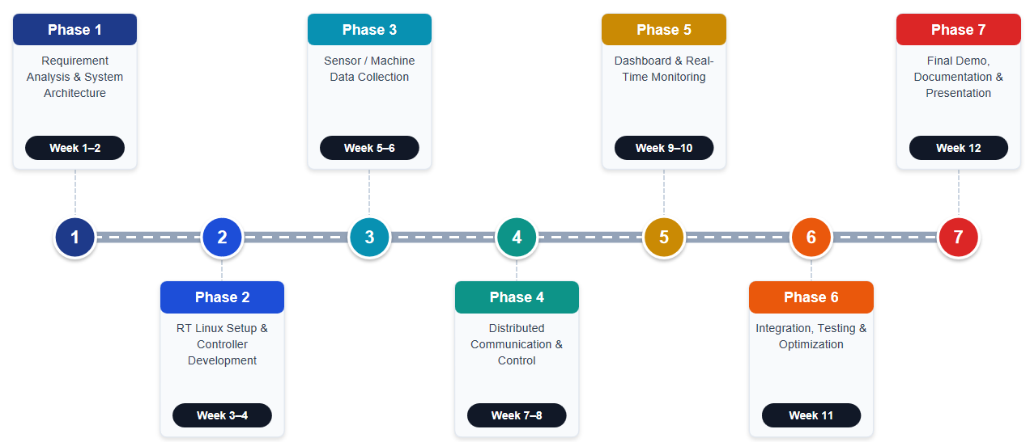
Feasibility and Project Plan
TIMELINE CHART FOR EACH PHASE OF YOUR PROJECT SHOULD BE THERE AFTER EXPLANATION
Phase | Activities | Timeline
Phase 1 | Requirement Analysis & System Architecture | Week 1–2
Phase 2 | RT Linux Setup & Controller Development | Week 3–4
Phase 3 | Sensor/Machine Data Collection | Week 5–6
Phase 4 | Distributed Communication & Control | Week 7–8
Phase 5 | Dashboard & Real-Time Monitoring | Week 9–10
Phase 6 | Integration, Testing & Optimization | Week 11
Phase 7 | Final Demo, Documentation & Presentation | Week 12

